Slide 1

Truss Issues
Do you TRUST your TRUSS..?

Slide 2
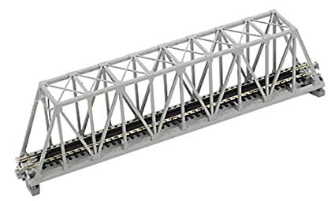
The Problem-
Bridge collapses in the last 6 months
300 lives lost
6 weeks to design a Truss Bridge manually
Resource wastage

Slide 3
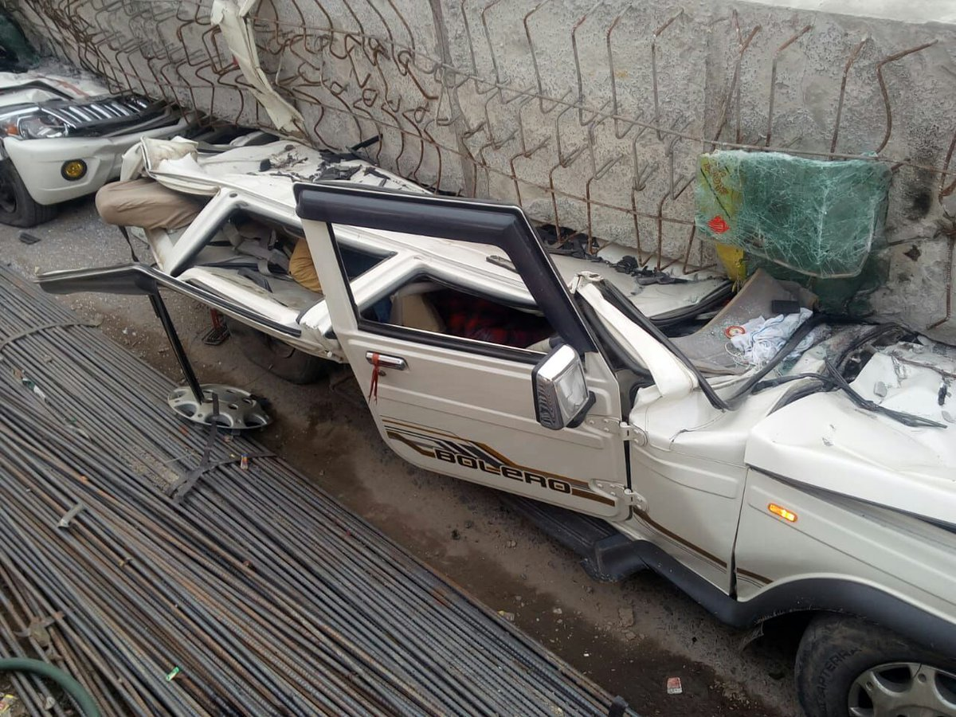
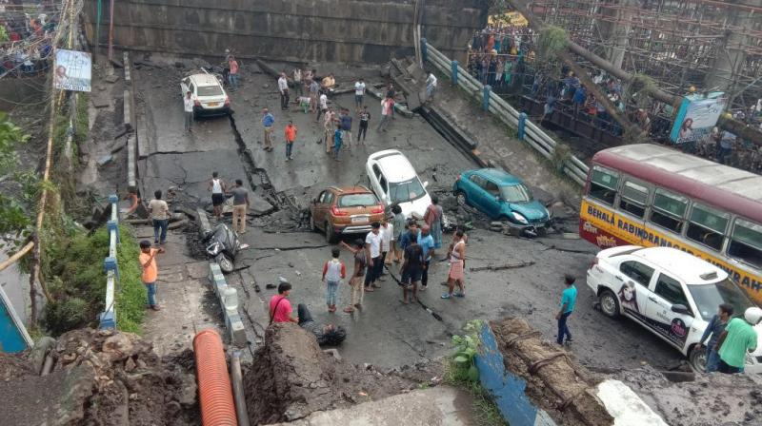
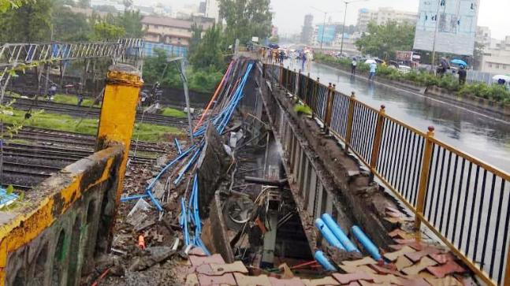
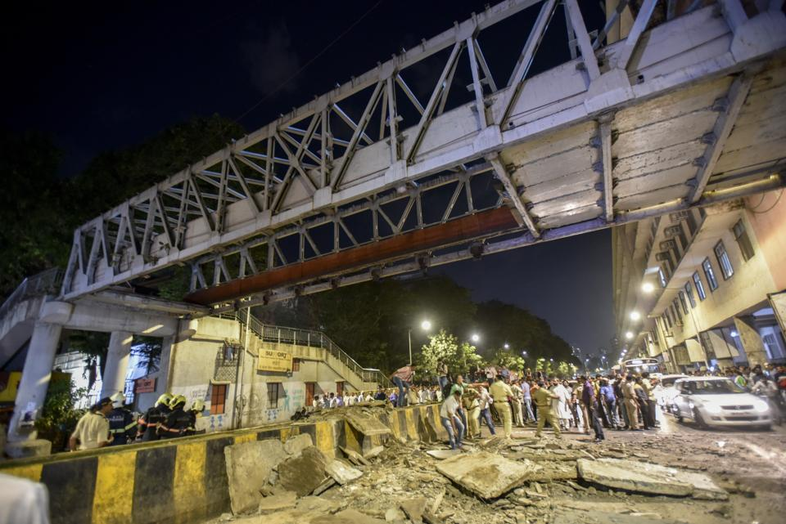

Slide 4
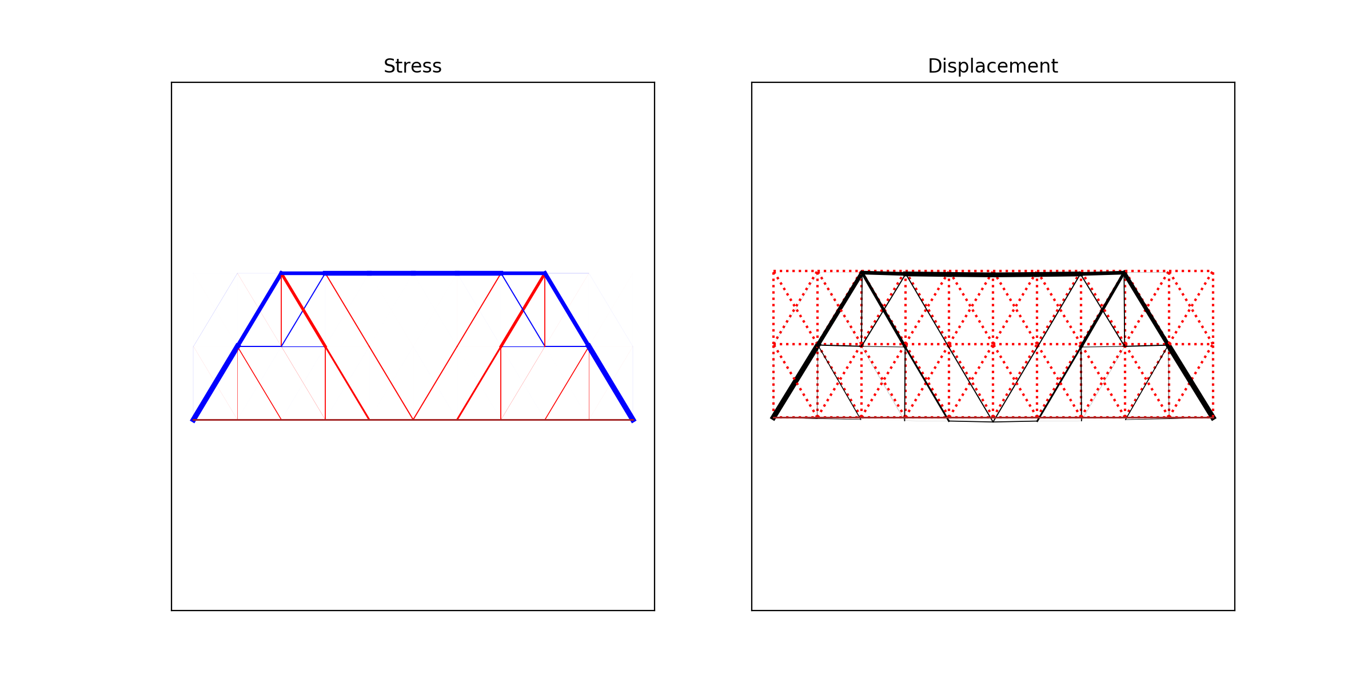
Optimized Design Generation

Slide 5
In 60 Seconds…
Enter Bridge
Dimensions
Assign Constraints
Generate The Most Cost-Effective, Reliable Bridge

Slide 6

Technology Stack -
Genetic Algorithms
Non – Linear Programming
Jupyter App Mode
Virtual Reality on Unity

Slide 7
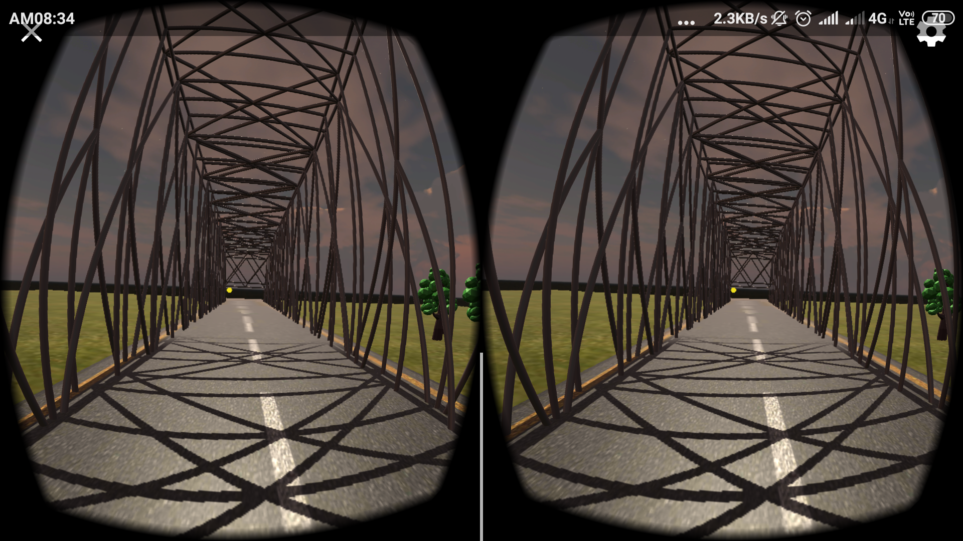
Our VR Prototype -

